Slide 1

Environmental Laboratory Informatics and Management System
Design Review I
Team LabRats
20 November 2018
Notes:
Add team graphic and labrats

Slide 2
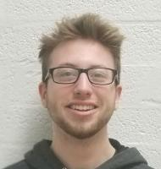

Team intro
Julian Bell
Team Leader
Communications
Remy Brandriff
Architect
Webmaster
Notes:
Add photos from old slides

Slide 3

Context of Problem
The Environmental Engineering lab at NAU supports state-of-the-art research into pollution, soil, water, hazardous waste, and natural resources, among others, for students and faculty, and industry professionals.
Why is that important?
Research performed here at the CENE lab has wider applications solving problems in the global environment to help ensure the safety and health of our planet
Poor environment -> Earth is unable to sustain life
Notes:
broader problem area, why problem is important and what is the future of the research topic

Slide 4

Sponsor
Dr. Terry Baxter
Professor in the Environmental Engineering program
Oversees the Environmental Engineering labs along with lab manager, Gary Slim, E.I.T., as well as supervising student research
His and students’ research performed in the lab contributes to global EE efforts, but the current workflow for lab usage and management is “severely lacking,” and makes the lab difficult to use
Notes:
Who is the sponsor, what is his business, and how it fits in broader context, w/ picture, brief bio, client’s area and what he cant do w/o software, and the future

Slide 5
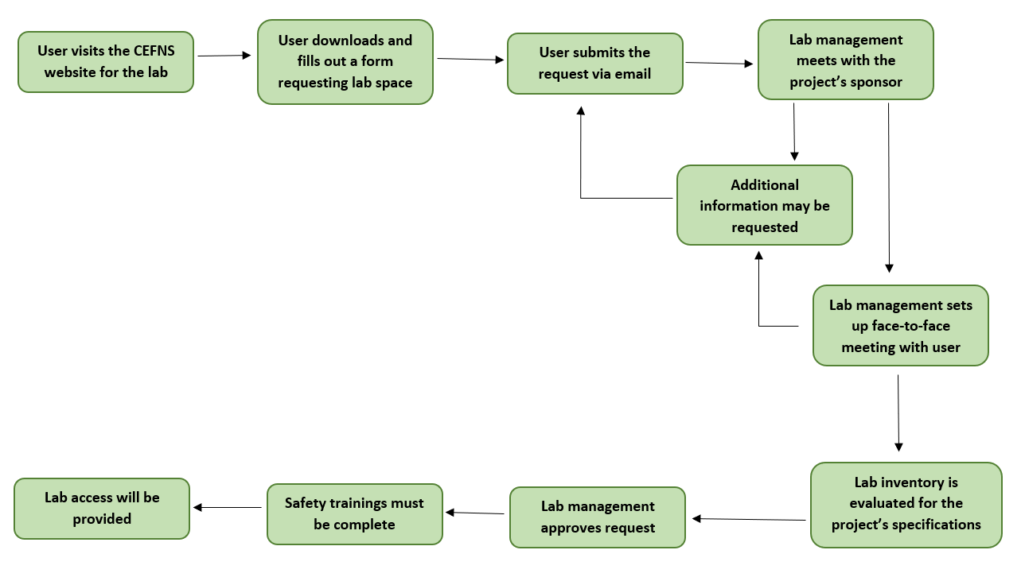
Current Workflow
ENE Laboratory Usage Request Process
Notes:
current work process, architecture /workflow diagram

Slide 6

Problem Statement & Importance
Environmental Engineering Lab handles use requests / chem. inventory
System runs entirely through paper / email
They need a proper system to handle this in a single central location
A system like this is critical to safe, efficient lab operations
Especially as university and budget for lab grows
Failure in lab safety can lead to failed projects and faulty data, dangerous chemical interactions, and health risks
Notes:
Specific problem for our project, what problem do they have, need to say WHY it’s important. MORE DETAILS

Slide 7



Competitive Solutions
Mobile app | ✓ Portable, fast, continuous availability ✗ Not ideal for lab management, too many features slow it down
Desktop software | ✓ Makes it easy to have a lot of features and different modes ✗ Cross-platform compatibility, software updates, installation
Notes:
look at competitive solutions-- are there any? Why they don’t work?

Slide 8
Solution overview
Web app | An app that allows users to make requests for lab space and check the lab’s current inventory, and lets lab management maintain the lab with a bird’s eye view of the space ✓ Portable ✓ Platform independent ✓ Secure ✓ Zero installation for users ✓ Easy to have different user levels & capabilities ✓ Easily maintainable
Notes:
TOP overview, go too deep, general outline

Slide 9
Our Solution
The web app will include
Different level of user access -- regular users, and administration/Lab Management -- and customization of user settings
A request form that simplifies the existing process into one step
A way for users to search the lab’s current chemical inventory and find out what they need to request
Automatic notification of necessary healthy and safety trainings
Tools for admin users to supervise and manage the lab space in the app
Hosted locally at NAU on servers provided and maintained by ITS
Notes:
General outline of solution vision. 3-5 features, be more explicit what the features are and add more

Slide 10
Fixing the Problem
Automation, convenience, efficiency
Different levels of user access -> allows administration to monitor app based on their needs
Online request form greatly reduces overhead/efforts to coordinate lab space
Complete database of chemicals with the means to find specific ones and request them if they’re out
Streamlines lab management processes in one easy location
Notes:
Highlight solution features clearly, address how they fix client’s problem? Automation, combines multiple steps in one form. Be more clear.

Slide 11
Intro to Requirements
Our requirements have been determined through discussion with Dr. Baxter and his team, in an effort to develop a solution suited to their needs.
There are 2 requirement aspects:
User requirements
System requirements
Functional
Non-functional
Environmental
Notes:
Talk about the acquisition, how we got the requirements. We have 2 aspects: user and system, and then we have functional, non-functional, environmental.

Slide 12
User Level Requirements
At a top level, this web application will be simple to use, and allow users to:
Register for an account tied to NAU’s CAS email system
Submit and check on status of requests for use of the EE lab
Look at databases of all chemicals lab has onsite
Also open safety and informational sheets as provided
Notes:
Simple to use, explain the concepts associated w/ project

Slide 13
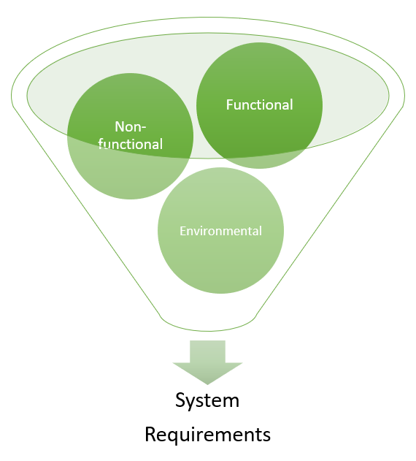
System Requirements
System requirements fall into 3 categories:
Functional
Define the system capabilities and functionality
Non-functional
Define the system’s performance
Environmental
Define the context the system exists in
Notes:
Intro, saying it has 3 parts: functional, non-functional, environmental

Slide 14
System Requirements: Functional
The system will:
Store data securely
Accept data from user input
Process user authentication
Support two types of users: standard and administrative
Integrate with the existing systems
A.C.I.D.
BioRAFT
User Type | User Capabilities
Admin users | Manage user accounts, lab inventory, requests, and how the lab is represented in the system; contact standard users
Standard Users | Make a request for lab usage; manage existing requests and view history; search lab inventory; contact administrative users
Both | Login/create account; manage user settings; request new inventory

Slide 15
System Requirements: Non-Functional
The app should...
Load quickly
Work reliably
Respond quickly to user input
Be easy to maintain
Support data integrity
Key Requirements
Speed
Usability
Extensibility
Scalability
Accessibility
Notes:
performance

Slide 16
System Requirements: Environmental
This system will operate within NAU’s ITS software ecosystem
C#
Microsoft technology ecosystem (.NET Core, Azure servers, etc.)
Our system must be easily integrated into the ecosystem
It must also
Have cross-browser compatibility
Be able to meet our requirements on multiple platforms
Notes:
Environmental constraints

Slide 17
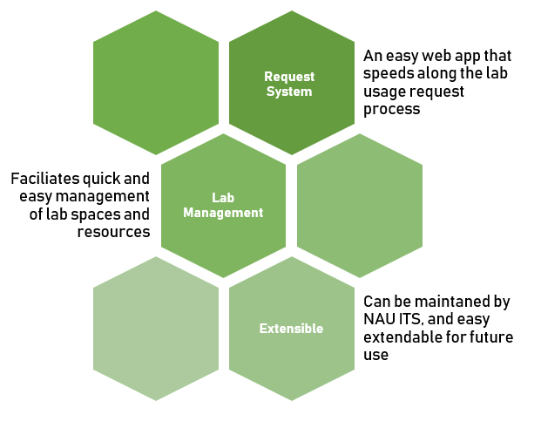
Requirements: Summary
We obtained requirements information from:
Client and faculty meetings/interviews
Documents given to team by EE staff
A robust web application
Lab requests
View inventory
An inventory system that integrates with existing tools
Chemical inventory
Store all relevant information related to lab
Integrate with ACID and BioRaft
Built in mind for future ITS support
Notes:
Just talk about acquisition and process it took to get here. This is the summary of the above slides! examples.

Slide 18
Challenges
Integration issues
Registration problems
Request form problems
Non-working inventory (discrepancies, etc.)
Issues with learning ITS-based toolset
Hazards/risks created from incorrect configurations
Notes:
Outlines main challenges, and will whittle down

Slide 19
Feasibility and Risks
The biggest issues will likely include:
Integration problems
Inventories
BioRAFT and ACID integration
Microsoft tools
.NET Core, SQL Server
Ensuring we have a solid understanding of tools provided
Notes:
Reduces, use of feasibility studies to narrow down and reduce risk

Slide 20
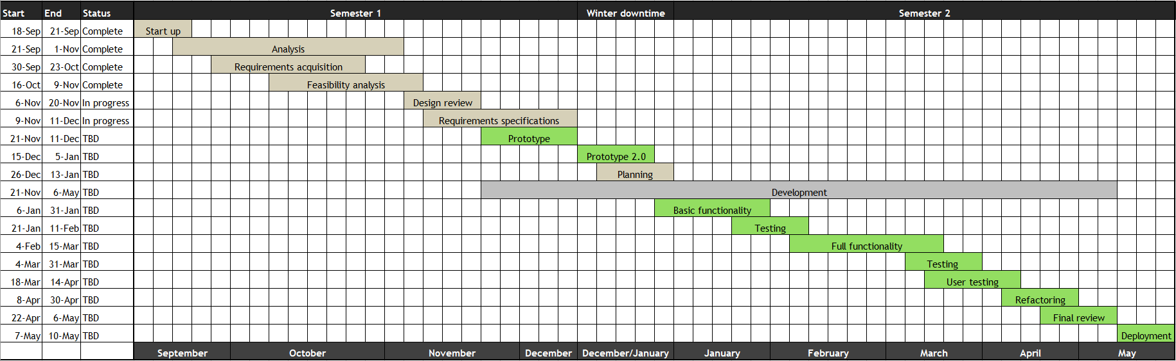
Project Schedule
Currently learning .NET Core in preparation for tech prototype
Web forms
Integrating with SQL server
Planning tech prototype implementation
Producing the request system using the evolutionary method as proof of concept
Writing requirements document
Notes:
Gantt schedule, at good level of detail. 1 page, walk through timeline, highlight tasks/progress

Slide 21
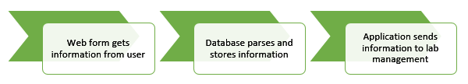
Conclusion
The Environmental Engineering Lab critically needs a system of this type to operate efficiently and safely
Our work can provide a robust web application to:
Handle requests for use of lab
Process all inventory information in a central location
Do all of this in a safe, secure manner which ITS can build on in the future
Prototype will demonstrate the request system and serve as proof of concept
Notes:
repeat project motivation, 1 slide, combine w/ below
Close w/ positive statement regarding outcome, and impact

Slide 22
Questions?

